Slide 1
Complex Planning and Optimization Problems
Part 2: Experiment, Experiment, Experiment!

Slide 2
Repetition
Why are Planning and Optimization similar?
What activities does a Planning/Optimization project usually involve?
Why is it important to challenge your assumptions?

Slide 3
Goal of this learning unit: Best Practices
Problem Formulation
Clean Code
Clean Methods
Automated Tests
Algorithm Selection
Algorithm and Data Structures
Evaluation
Clean Project
Version Control
Experimentation
Python Environments

Slide 4
Sessions
Session 2: Experiment, Experiment, Experiment!
Part 1: Diving Deeper
Part 2: Evaluation
Part 3: Module Tips
Notes:
Today we will discuss the four parts mentioned in the slide.

Slide 5
Types of Experiments
Side-Experiments
Complex Research Questions
Part 1: Diving Deeper
Revisiting
Quality Criteria

Slide 6

Reminder: We are Detectives
The goal: Try to find out if Person A has been in communication with Person B
The Complication: They may have used a third person to obfuscate their tracks.
The Evidence: We traced emails and know who has been writing to whom.
Side-Goal: Time is of the essence!
Notes:
A quick reminder of what our running example is.

Slide 7
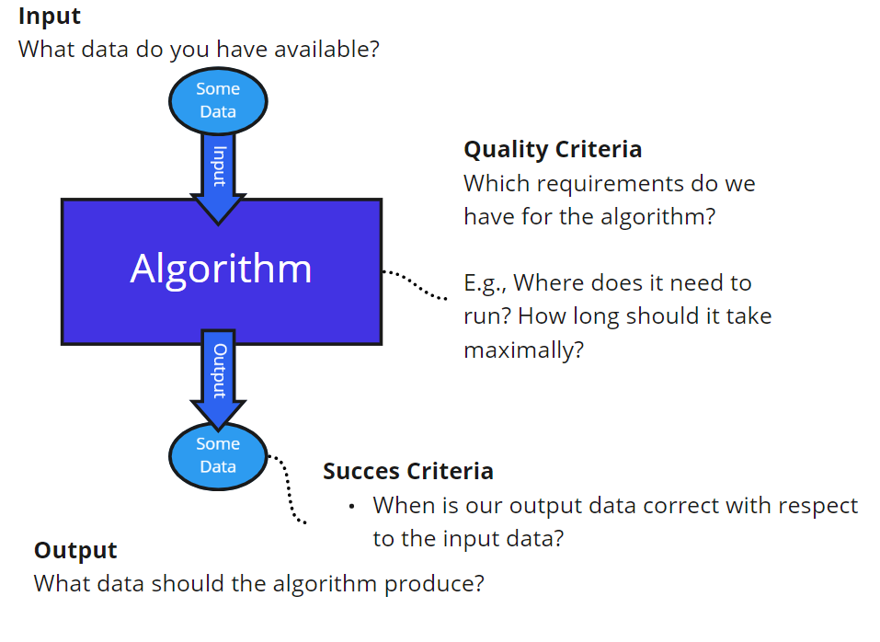
Problem Formulation
Input:
G: Directed Graph, no node information
A: Node
B: Node
Output: True/False
Success Criteria:
True => there is at least one path from A to B in G
False => there is no path from A to B in G
Quality Criteria: minimize time to calculate output on average over all runs.
Notes:
… And what it looked like as a formalized problem.

Slide 8
What we accomplished last time
Defined Problem
Compared Uninformed algorithms
Found more options to test by challenging our assumptions
Today we pick up one of them
 | BFS | DFS | Dijkstra
Average Time | 101 ms | 76 ms | 206 ms
Notes:
While we had initial results last time, we also found that a lot of the assumptions we made along the way could be challenged. This opened up a lot of additional avenues to pursue. Today we explore one of them: Graph Visualization.

Slide 9
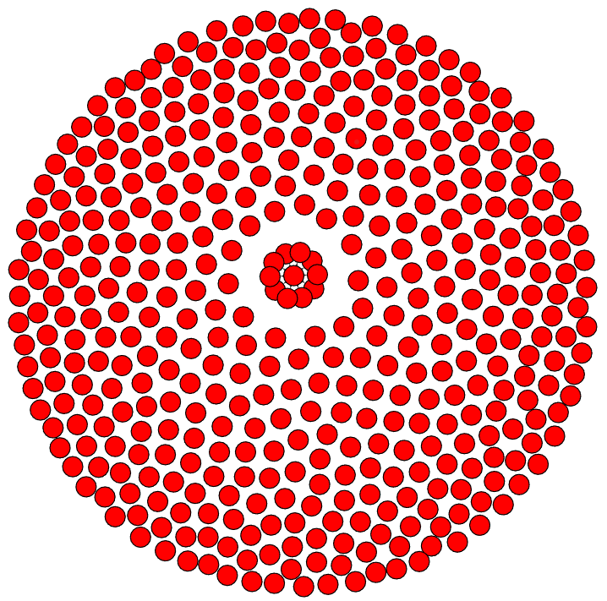
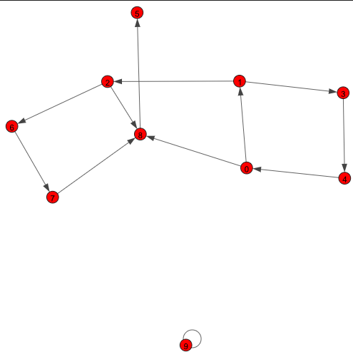
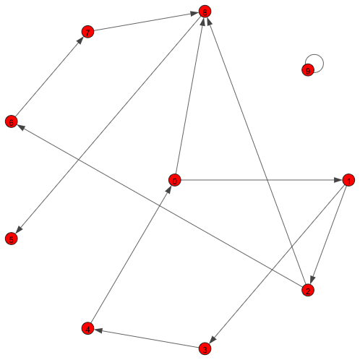
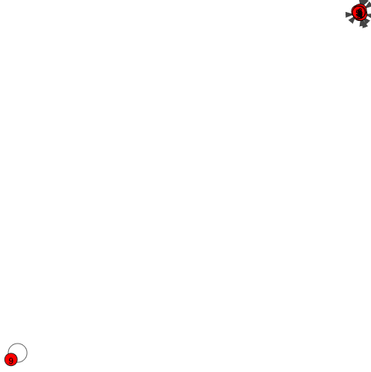
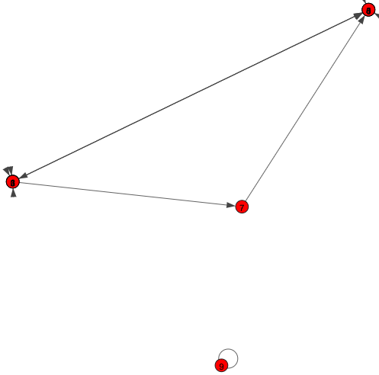
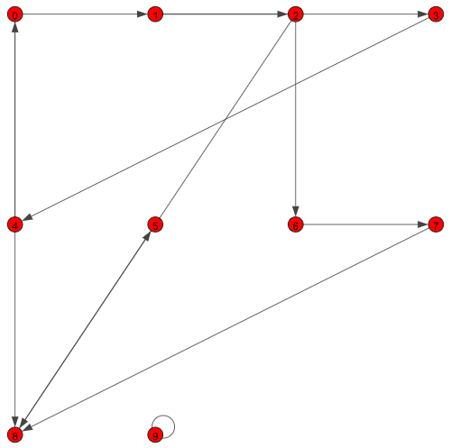
Graph Layout
Purpose: visualization of graphs
Could these coordinates be useful for informed search (e.g., A*?)
Maybe?
But which one?
Experiment!
y
x
Notes:
Graph layout algorithms assign coordinates to nodes in a graph in order to visualize them. They usually aim for a good visualization and minimize properties such as overlap of nodes or edges.
These coordinates could also be used by an informed algorithm, such as A*. But would they be useful?
Well… it depends. The slide above shows different visualizations made with different layout algorithms. Some of them seem more useful than others.
It seems like we will have to experiment more …

Slide 10
Which questions do we need to answer?
Which layout algorithms are suitable for shortest path search?
Which layout algorithms can cope with a graph of this size?
Which layout algorithm / informed search algorithm combination works best?
Notes:
For determining which combination of layout and search algorithm is the best candidate we will need to answer a set of sub-questions.
The main questions are listed above and will be discussed in the next slides.

Slide 11
Which layout algorithms are suitable for shortest path search?
When does A* work best?
Assumption: distance-based heuristic
Distances should be proportional to path length
How do we evaluate this?
Experiment!
coordinate_annotation_experiment.ipynb
Notes:
For our first question, we should select which algorithms are suitable for a shortest path search algorithm in the first place based on their properties.
Our assumption here is that we use a distance-based heuristic such as Euclidian or Manhattan Distance. For an informed algorithm, such as A*, to work well, the information encoded in distances should be meaningful. In the best case, we would like the distance to a node to be extremely close to the actual distance of the path of that node, meaning we want nodes that are reachable from each other to also be close by and nodes that require shorter paths to be closer than nodes that require longer paths.
How do we evaluate this? It will require us to experiment with the existing algorithms to observe these properties. You can find the experiment described in coordinate_annotation_experiment.ipynb.

Slide 12
Which layout algorithms can cope with a graph of this size?
Issues with big graphs
Impact of exponential complexity
Memory issues
Experiment!
generate_coordinates.py
Run all algorithms 5 times
Store results for further processing
Manual exclusion in case …
Out of Memory
> 1h runtime
Algorithm | >1 h | OOM
auto | No | No
davidson harel | Yes | No
drl | No | No
fruchtermanreingold | No | No
graphopt | Yes | No
kamada kawai | No | Yes
mds | No | Yes
Notes:
The second question revolves around technical limitations. The tests performed in the previous experiment were based on a small graph. There are some issues that only show up with big graphs where the exponential complexity of algorithms is more visible and can lead to intractably long run times or out of memory issues.
These issues are often only felt when applying the algorithm to the target graph. The script generate_coordinates.py was no different. The script runs each algorithm 5 times and stores the coordinates for further experiments. While doing this, we noted that two of the algorithms produced out of memory issues. Two others took infeasibly long and have been stopped when the run time exceeded one hour. These algorithms have been excluded from further experiments.

Slide 13
Which layout algorithm / informed search algorithm combination works best?
Experiment!
→ informed_algorithm_experiment.ipynb
Notes:
The previous experiment provided the foundation for selecting the best layout algorithms. We now know that we need to compare “auto”, “drl” and "fruchterman_reingold”.
We also collected five different coordinates generated by each of these algorithms that we can now test.
First, we’ll answer the question of which of these collected datasets is best.
Second, we’ll use the best algorithm / dataset to determine the best informed search algorithm.
Both experiments are in the referenced notebook.

Slide 14
Complex Research Questions
Sometimes you need more than one experiment to…
Make choices / narrow down options
Validate design decisions
Make preliminary viability tests
How to structure this?
Start with a general research question
Break down into sub-questions
Answering all sub-questions should answer the top-level one
Experiment or break down further
Notes:
Sometimes a research question is too big to be answered with a single experiment. This could be because you need to make certain choices or narrow down your options before doing the main experiment. Or it may be that you need to validate a design decision to make sure you’ve made the right one. Or maybe you need to test certain options for viability.
A good approach to structure this for yourself is to break down your general research question into sub-question. Ideally you want to get to a granularity where you can answer each sub-question with an experiment and where answering all sub-questions will answer your overall question. For this you may sometimes have to further break down your sub-questions questions into even more basic questions.

Slide 15
A few types of Experiments
Exploration
Goal: Understand your data, an algorithm, …
Usually, a mixture of manual observations and calculation of properties
Research
Goal: Identify options, benchmarks,…
Usually involves structured search in internet or literature
Reasoning
Goal: Make design decisions based on known facts.
May involve looking up properties, deductive reasoning, proofs,…
Notes:
There are a lot of different types of experiments. Here are a few examples of the types of experiments involved in this project.
Some of them might even not look like an experiment (or might successfully be argued to not be an experiment at all).
However, they have in common, that they profit a lot from:
Having an explicit question as guidance
Having a g
A note on research: this was not explicitly included via an experiment protocol, but of course design decisions, like which graph layout algorithms to use, have been underpinned by a period of searching for options and evaluating them (a combination of research and feasibility).

Slide 16
A few types of Experiments
Feasibility Study
Goal: test if something is feasible / efficient enough to be considered
Usually related to quality criteria
Comparison
Goal: Select among several options
Usually involves testing and comparing
Notes:
There are a lot of different types of experiments. Here are a few examples of the types of experiments involved in this project.
A note on research: this was not explicitly included via an experiment protocol, but of course design decisions, like which graph layout algorithms to use, have been underpinned by a period of searching for options and evaluating them (a combination of research and feasibility).

Slide 17
Desiging Experiments
Design around your research question.
Experiments should give clear answers
Experiments should not do too much at once
Manual vs. Automated
Depends on the nature of the experiment
Manual experimentation should also follow a method
Automated experiments could run on a server or over-night
Write your test cases before your experiments!
Notes:
In the end, the experiments you set up should be clearly designed for a purpose – often to answer a question for you.
In addition to the different types of experiments on the previous slide, you can also look at them in terms of how much automation they include. This depends on the type of experiments. Sometimes it’s fine to play around with things on your own. Sometimes you want to run things in the cloud over night. In all cases following an explicit methodology is a good idea.

Slide 18
Part 2: Evaluation

Slide 19
Where we should be now …
Which algorithm is best?
What properties does our graph have?
Which basic uninformed algorithm is best?
Which informed algorithm is best?
(Which extended uninformed algorithm is best?)
(Which transitive closure is best?)
Notes:
By now we have derived multiple smaller questions from the main research question.
We have answered the first three of them. For the sake of brevity, we have excluded the last two questions from the learning unit, but in a real project, those would have been explored as well.

Slide 20
Where we should be now …
Which algorithm is best?
What properties does our graph have?
Which basic uninformed algorithm is best?
Which graph representation is best?
Which List/Queue is best?
Which algorithm performs best?
Which informed algorithm is best?
Which layout algorithms are applicable?
Which of them is best?
Which algorithm is best for this layout algorithm?
(Which extended uninformed algorithm is best?)
…
(Which transitive closure is best?)
…
Notes:
Some of these questions required us to answer sub-questions as well. This is normal as we need to explore unknowns, make design decisions, and compare alternative options.

Slide 21
Where we should be now …
Which algorithm is best?
What properties does our graph have?
Which basic uninformed algorithm is best?
Candidate 1
Which graph representation is best?
Which List/Queue is best?
Which algorithm performs best?
Which informed algorithm is best?
Candidate 2
Which layout algorithms are applicable?
Which of them is best?
Which algorithm is best for this layout algorithm?
(Which extended uninformed algorithm is best?)
Candidate 3
…
(Which transitive closure is best?)
Candidate 4
…
Notes:
As a result of each of the questions we have one (possibly more) candidate algorithms that may be the overall best.

Slide 22
Where we should be now …
Evaluation
Which algorithm is best?
What properties does our graph have?
Which basic uninformed algorithm is best?
Candidate 1
Which graph representation is best?
Which List/Queue is best?
Which algorithm performs best?
Which informed algorithm is best?
Candidate 2
Which layout algorithms are applicable?
Which of them is best?
Which algorithm is best for this layout algorithm?
(Which extended uninformed algorithm is best?)
Candidate 3
…
(Which transitive closure is best?)
Candidate 4
…
Notes:
What remains now is one final experiment to evaluate these candidates to find out which algorithm actually is best.

Slide 23
Evaluation
Compare Candidate Algorithms
See evaluation.ipynb
Criteria: Success and Quality Criteria
This may require some consideration!
E.g., which properties can be proven?
E.g., how to factor in graph layout algorithm?
Make this one count!
Statistically significant
Avoid Overfitting
Don’t forget to interpret and check for plausibility!
Notes:
The evaluation experiment is typically the capstone or the entire project and enables you to select from all the options you have identified as viable in the previous experiments.
The evaluation criteria should be defined from the planning / optimization problem. This shouldn’t be news, since we have used them for the other experiments as well. It is important to stress though that you should put some consideration into what and how you evaluate them. On the one hand, there are some properties that don’t have to be evaluated because they have already been proven for certain algorithms. For example, all of the path finding algorithms we have applied are guaranteed to find a path if it exists in the context we apply them in (directed, finite graphs). This enables us to skip this during evaluations.
On the other hand, specific setups made for certain algorithms may complicate the evaluation. One detail we have ignored in previous experiments is that running a layout algorithm also takes some time. If we compare only the run time of individual algorithms on the already layouted graph, we run the danger of ignoring the time taken to layout the graph. Depending on the setup, this may or may not wanted. For example, if we optimize for request time in context of a web-site then the preprocessing time can probably be ignored. On the other hand, in our running example, where we want the results as soon as possible, the layouting algorithm delays the results. In this case, it may be important to find out starting at which number of requests the algorithm becomes faster (if the informed algorithms are faster than the uninformed algorithms anyway).
Since this is the final experiment that will likely be the foundation for your conclusions, this one should count. If you look into the experiment notebooks, you will note that we have run this algorithm with 10 times more samples than the previous experiments. This is to increase the statistical significance of the result. You will also note that we have used a different random seed than in earlier experiments. Always using the same random seed runs a risk of overfitting to this seed – just like always using the same training and test split does in Machine Learning. Especially the final experiment should make sure to use an unbiased set of problems/data to test on.
Once you have the results you are not yet finished. You should interpret them. This has two purposes:
Checking the results for plausibility enables you to catch errors or identify validation experiments.
Absolute numbers often aren’t what we want. Our example problem has used an (intentionally) bad quality criterium by just saying that the algorithm should run as quickly as possible but not given a benchmark. To a real detective, it would probably make a difference whether the algorithm runs for a minute, an hour or a year. Interpreting the numbers we have seen in our experiment can help understand the actual quality of our solution better.

Slide 24
Part 3: Module Tips

Slide 25
What am I looking for in SE_37/38?
Results Design Decisions
Formulating the Problem
Success / Quality Criteria
Algorithm Selection / Configuration
Evaluation
How to make these design decisions?
Experiments!
For the module assessments, I’m more interested in your experiments than your source code.
Notes:
Looking back at this project, we can summarize a few points for the Planning and Optimization module.
The modules are not about results. It is clear that sometimes you don’t find a suitable options. They focus more on the design decisions made in all aspects of the module. And by now it shouldn’t come of a surprise that

Slide 26
Summary - How to approach an AI project?
Explicitly define your goals
Planning / Optimization Problem
This gives you a natural question
“What is the (best) algorithm to solve this problem according to success and quality criteria?”
Break it down into sub-questions
Answer your questions with experiments, proofs, …
Notes:
Summarizing, here is one way to approach a complex planning / optimization problem.

Slide 27
FAQs
Is X a planning or optimization problem?
What’s the state space like?
Graph -> Planning, Space -> Optimization
How complex is complex enough?
It’s about the experiments, not about the source code.
I want to see you make good design decisions founded on experiments.
You may use out of the box solutions but should validate whether they actually are optimal.

Slide 28
Questions?

